Slide 1

Examining brain-body relations in the metabolic domain: holistic versus analytic approaches
J PAUL HAMILTON
DEPARTMENT OF BIOLOGICAL AND MEDICAL PSYCHOLOGY
UNIVERSITY OF BERGEN
HBF meeting 6 May 2025

Slide 2

Metabolic status and its complicated history in psychiatry

Slide 3
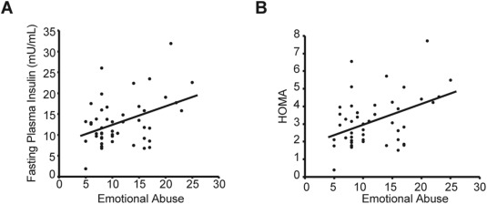
on the one hand…
Major depression is twice as prevalent in persons with than those without diabetes (Ducat et al., JAMA, 2014)
Insulin resistance—an index of metabolic disturbance—increases with (retrospectively assessed) childhood trauma (Nasca et al, Exp Neurol, 2019)

Slide 4
on the other…
Metabolic variables like BMI are often factored out in biological investigations of mental illness.
DSM differentiates between mental illnesses with known medical comorbidities – such as diabetes – versus those without.

Slide 5
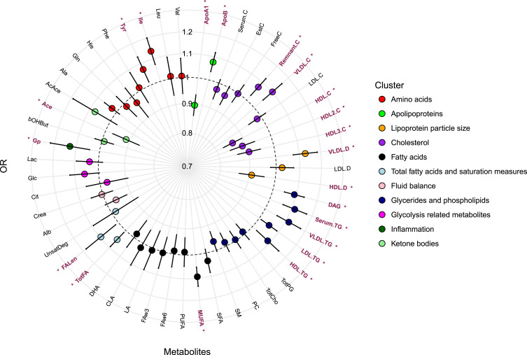
recent approaches
Bot et al., Biol Psych, 2020

Slide 6
current questions and challenges
Question
What are the neural-level implications of metabolic disturbance?
Challenge
Like many medical categories, metabolic disturbance is fuzzy and multifaceted; e.g., there are five criteria for metabolic syndrome:
abdominal obesity
high blood pressure
impaired fasting glucose
high triglyceride levels
low HDL cholesterol levels

Slide 7

current approach—association between metabolic-status variables and brain-structure volume

Slide 8
Study basics
117 participants
Predictor variables
blood apolipoprotein B:A1 levels
body mass index
Dependent variable
VBM-ed T1-weighted MRI

Slide 9
predictor variables: two indices of metabolic status
Body-mass index
Apolipoprotein B:A1 ratio
proxy for LDL:HDL (bad-to-good cholesterol ratio indexing risk for cardiovascular disease)
mass / height²

Slide 10
Relation between metabolic variables

Slide 11
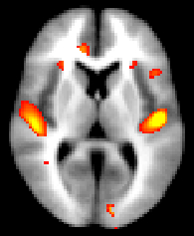
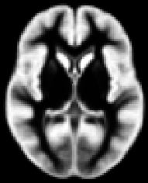
Dependent variable voxel-based morphometry provides voxel-wise estimates reflecting Grey matter density and volume

Slide 12
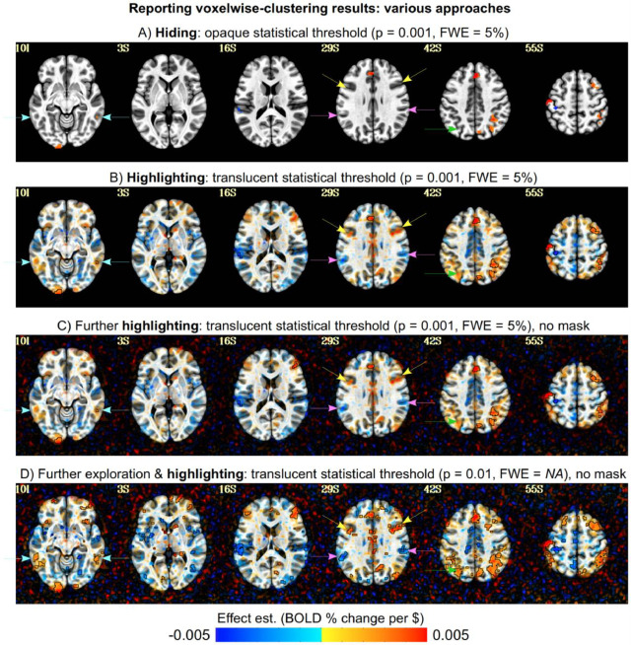
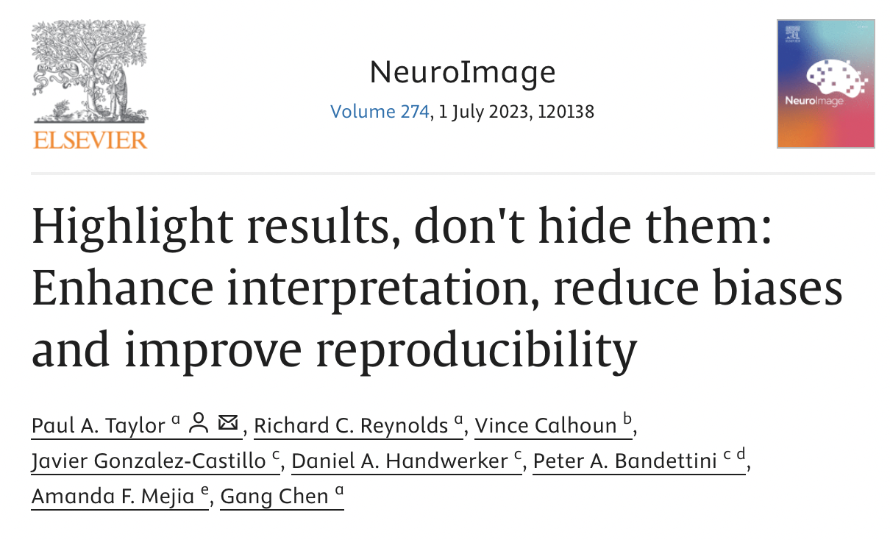
analysis

Slide 13
analysis
Use relatively loose statistical thresholds (current case: voxel-wise p = 0.05; cluster threshold = 80 voxels).
01
Apply an expanded array of partially independent statistical procedures, each with its own strengths and weaknesses.
02
Determine if full array of results converges on an interpretation.
03

Slide 14
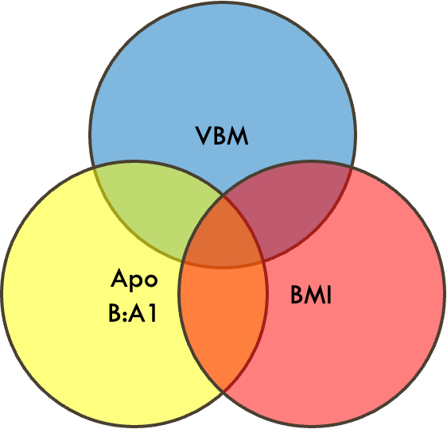
statistical procedures part one
Conventional approach to identifying effects of single variables after linearly factoring out influence of other variables. Involves subtracting out covariate effects; assumption dependent.
R²_{Apo(ApoBMI)} = variance in VBM accounted for by ApoB:A1 after VBM is residualized against BMI
R²_{BMI(ApoBMI)} = variance in VBM accounted for by ApoB:A1 after VBM is residualized against BMI
Checks on standard approach. Is there an effect there before covariate subtraction?
R²_{Apo} = variance in VBM accounted for by ApoB:A1
R²_{BMI} = variance in VBM accounted for by BMI
But what about the center of the Venn diagram?

Slide 15
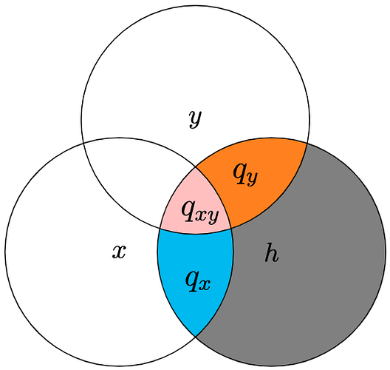
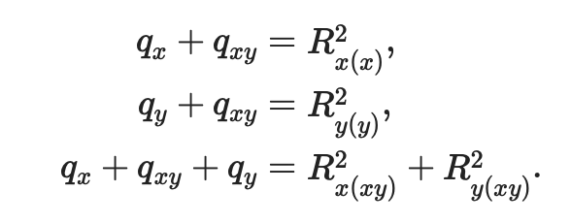
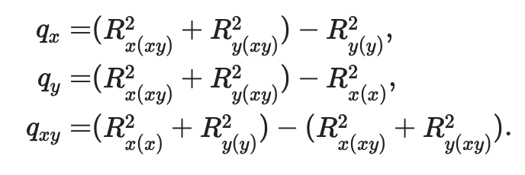
additional procedures nice properties of R², the coefficient of determination
→

Slide 16
novel partitioning of variance
VBM
p_{Apo} = complement to R²_{Apo(ApoBMI)} derived analytically as opposed to standard regression / subtraction
p_{BMI} = complement to R²_{BMI(ApoBMI)} derived analytically as opposed to standard regression / subtraction
p_{ApoBMI} = index of variance shared between overlap of Apo and BMI and VBM; lost in conventional regression approaches
Apo
B:A1
BMI
p_{Apo}
p_{BMI}
p_{ApoBMI}
p_{Apo} = R²_{Apo(ApoBMI)} + R²_{BMI(ApoBMI)} - R²_{BMI}
p_{BMI} = R²_{Apo(ApoBMI)} + R²_{BMI(ApoBMI)} - R²_{Apo}
p_{ApoBMI}=(R²_{Apo}+R²_{BMI})−(R²_{Apo(ApoBMI)}+R²_{BMI(ApoBMI)})

Slide 17
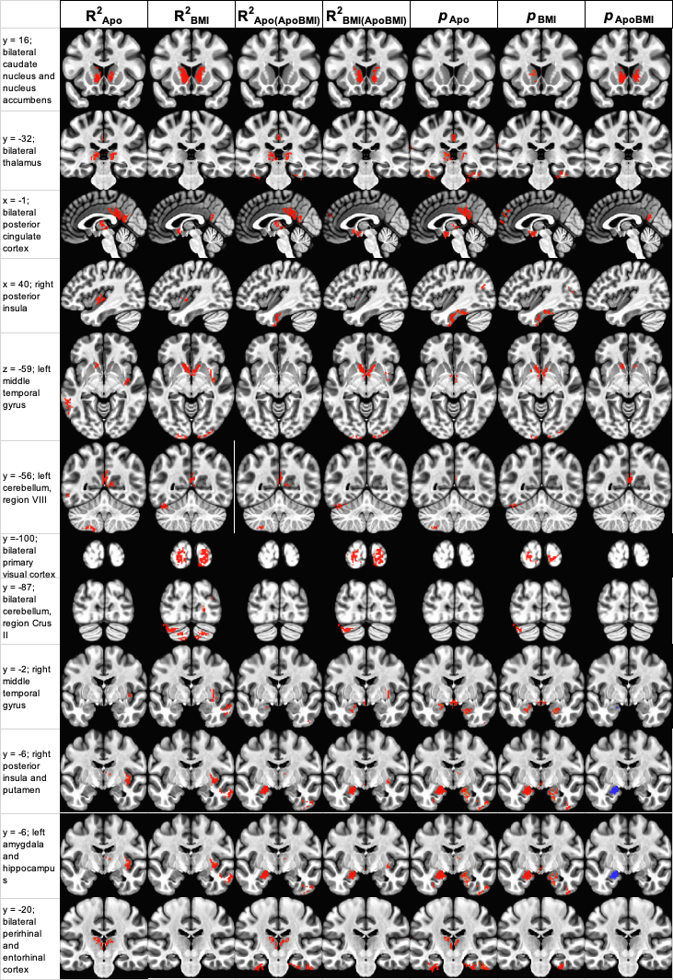
results: with great analytical power comes…

Slide 18
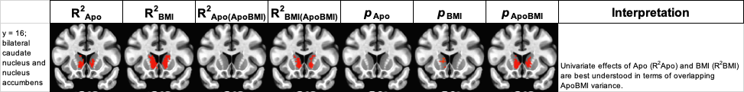
results reduction
STANDARD
APPROACH

Slide 19
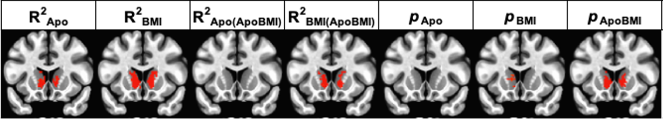
potentially worth further consideration?

Slide 20
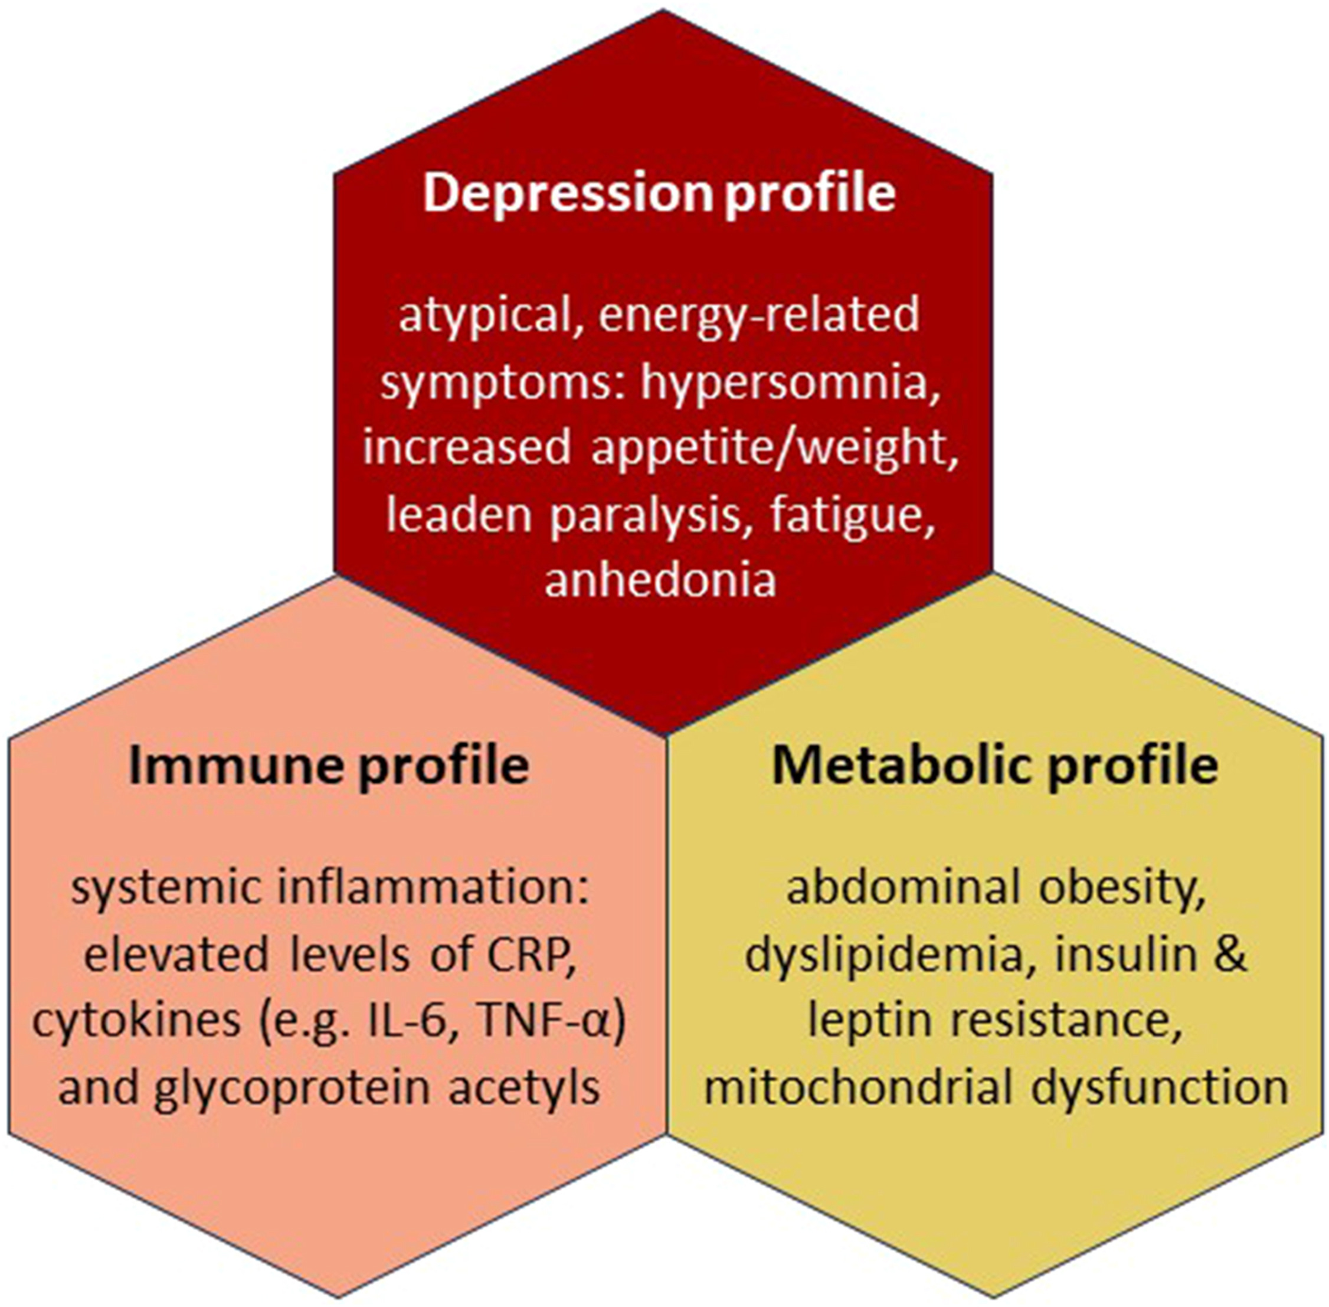
expanding the approach—adding inflammation
Penninx et al., Lancet, 2025

Slide 21
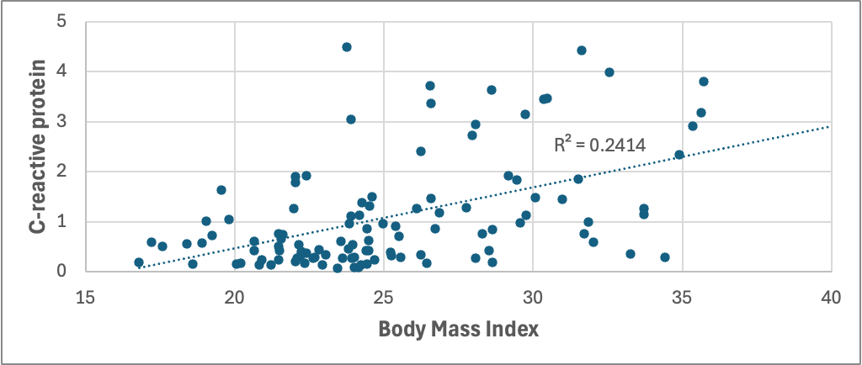
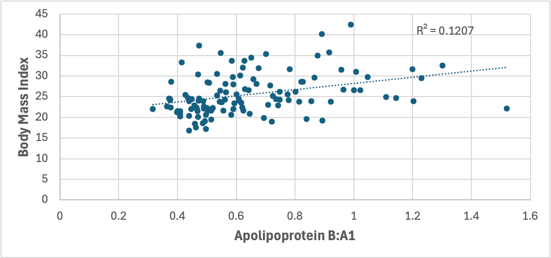
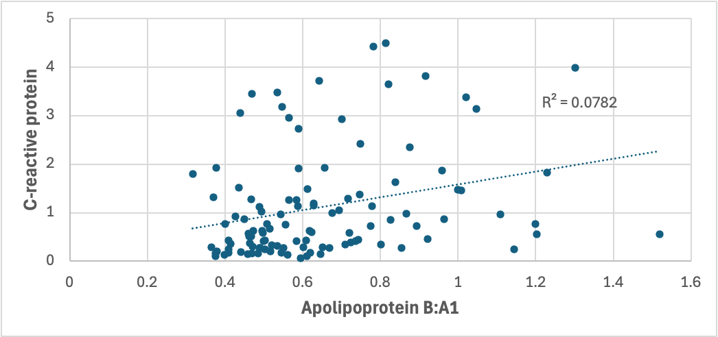
Relations in the three variable system

Slide 22
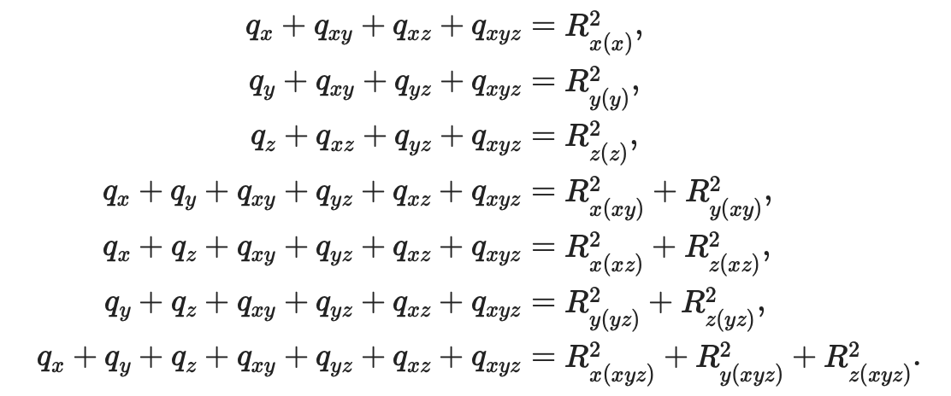
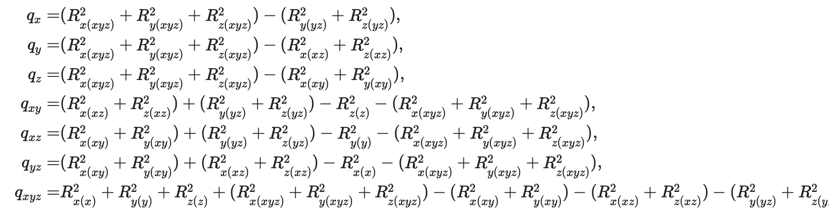
bigger system of equations
→

Slide 23
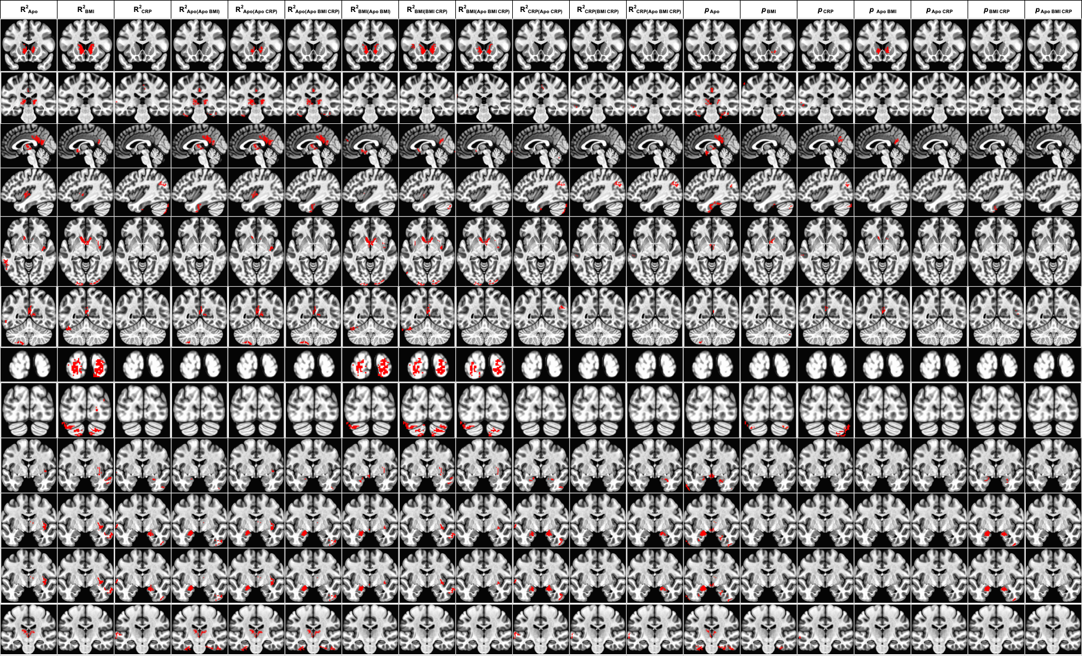
larger array of results

Slide 24
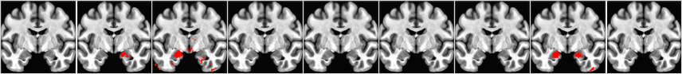
results reduction

Slide 25
summary
Body states are likey to relate to brain states in ways that are important in psychopathology.
Definitions and operationalizations ≠ constructs; instead, definitions and operationalizations ←→ constructs.
An expansive, more holistic approach to analysis can identify both opportunities and pitfalls (but to the detriment of elegance).
Current results support looking further at: 1) striatal volume in the overlapping space of bodily changes and dyslipidepia, and 2) hippocampal volume in the overlapping space of inflammation and bodily changes

Slide 26
people
Lars Östman: Linköping University
Robin Kämpe: Linköping University
Gäng Chen: National Institutes of Health

Slide 27

happy holiday!

